Slide 1
Analysis and Simulation on Coarse-Grained A/D Conversion Circuit
B11901027 王仁軒
PPT TemplateCredit : Jie-Hong Roland Jiang

Slide 2
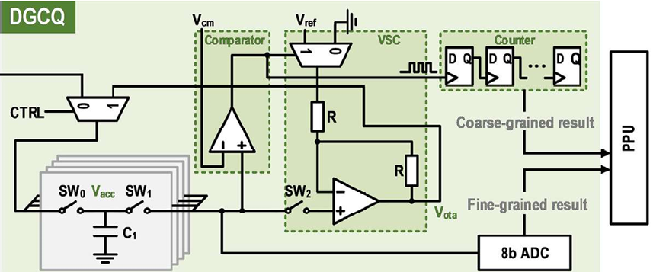
Recall
Dual-granularity cooperative quantizer
When quantizing analog voltage, use another ckt to calculate an approximated result
Low precision
Vs (MAC result)
High precision

Slide 3
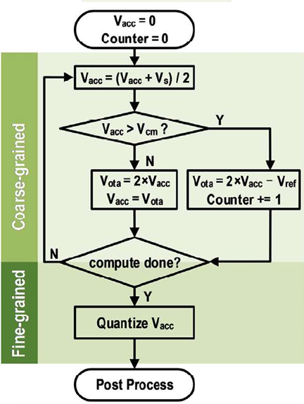
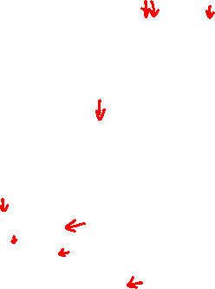
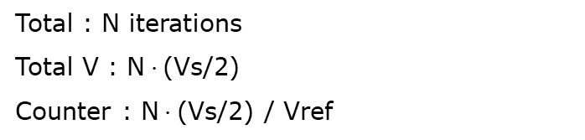
Recall
Dual-granularity cooperative quantizer
When quantizing analog voltage, use another ckt to calculate an approximated result
Low precision
Vs (MAC result)
Total : N iterations
Total V : N$⋅$(Vs/2)
Counter : N$⋅$(Vs/2) / Vref
High precision

Slide 4
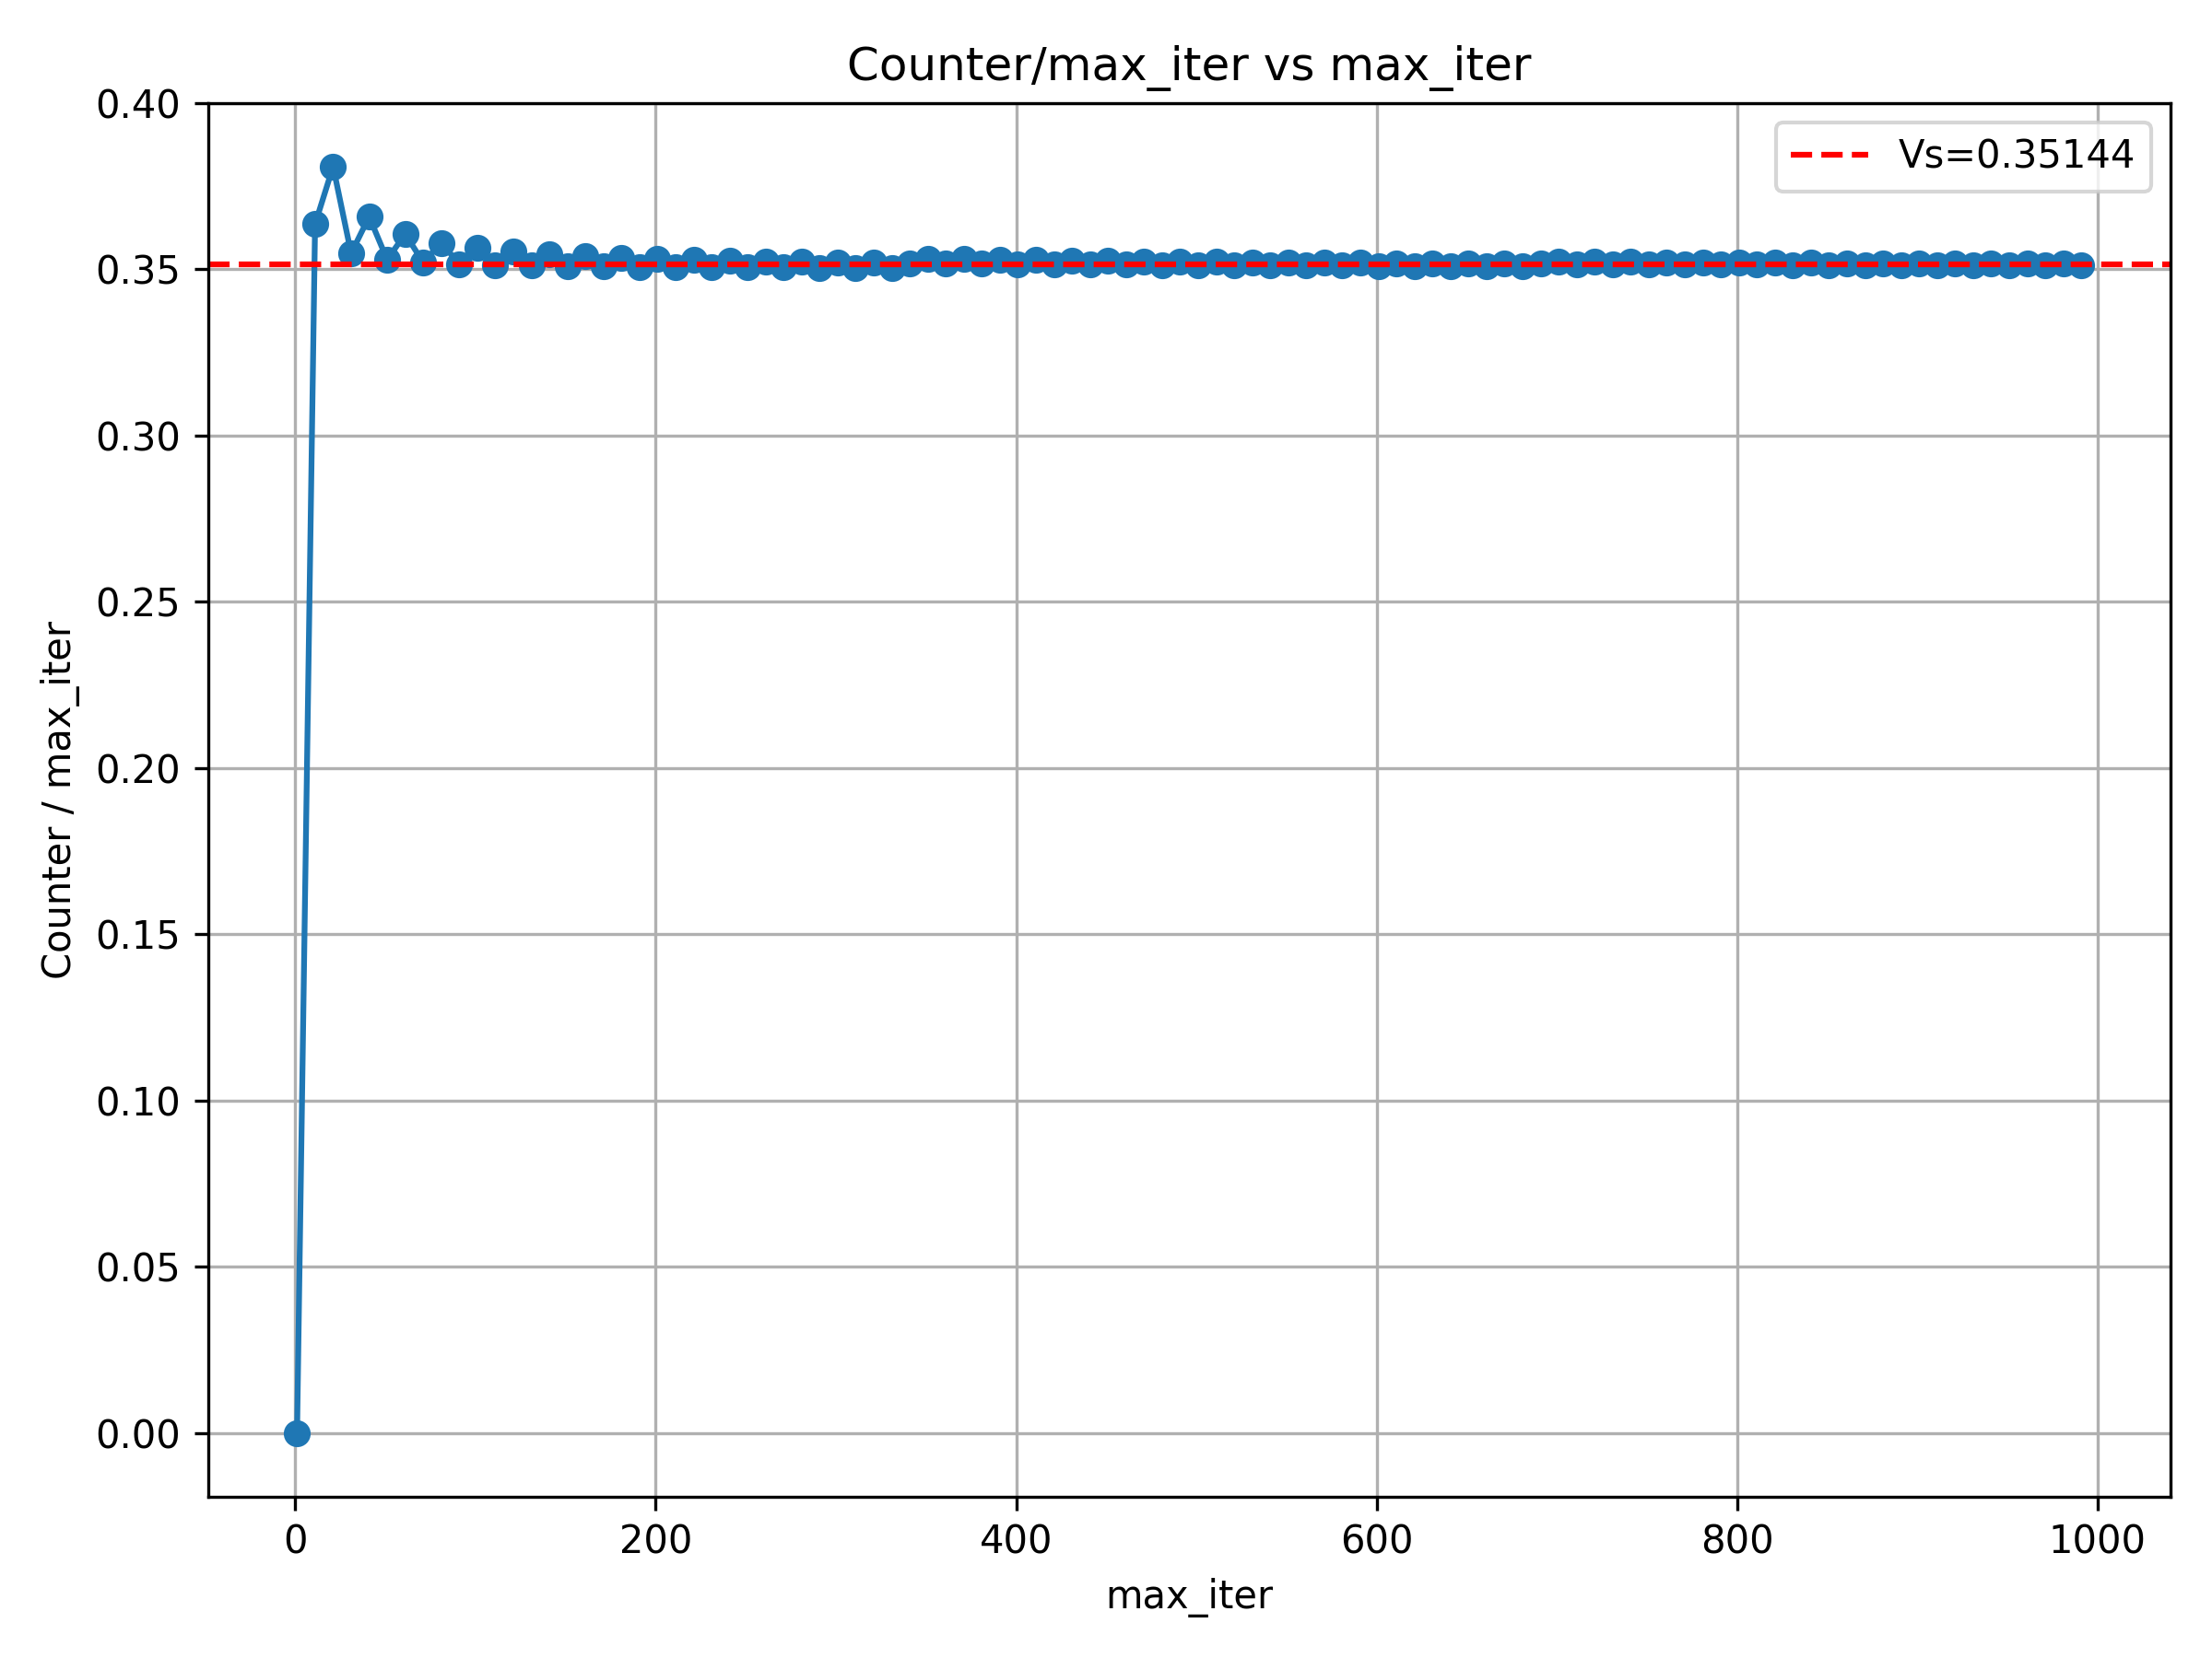
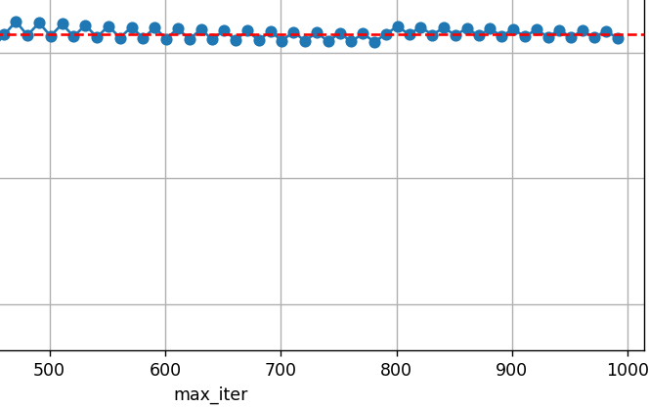


Effect of Iteration & Vcm & Vref
Iteration
Quantization result converges after 200 cycles
Remainder cannot -> 0 after many iterations
Red : $iter⋅\frac{V_{s}}{2}$
Blue: $N⋅\frac{V_{ref}}{2}$
Precision : Gain 1b precision after iteration x 2
Precision : Gain 1 digit precision after iteration increase by 10x
Precision cannot infinitely grow as a trade-off of latency + throughput

Slide 5
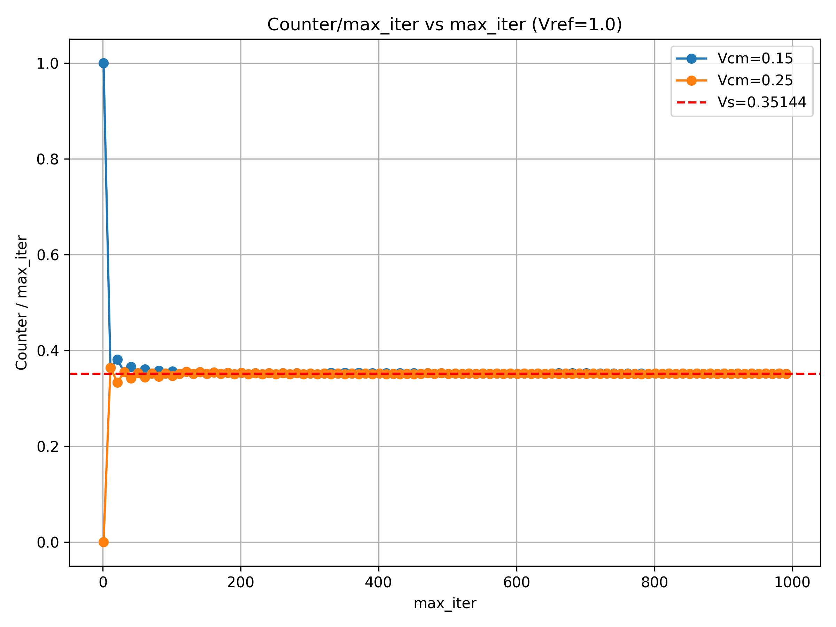

Effect of Iteration & Vcm & Vref
Vcm
Vcm has slight effect in this quantization method, as it is a threshold of Vacc to start calculating
Vcm < Vs/2
Quantized result starts from Vref
then gradually converges to Vs
Vcm > Vs/2
Quantized result starts from 0
then gradually converges to Vs

Slide 6
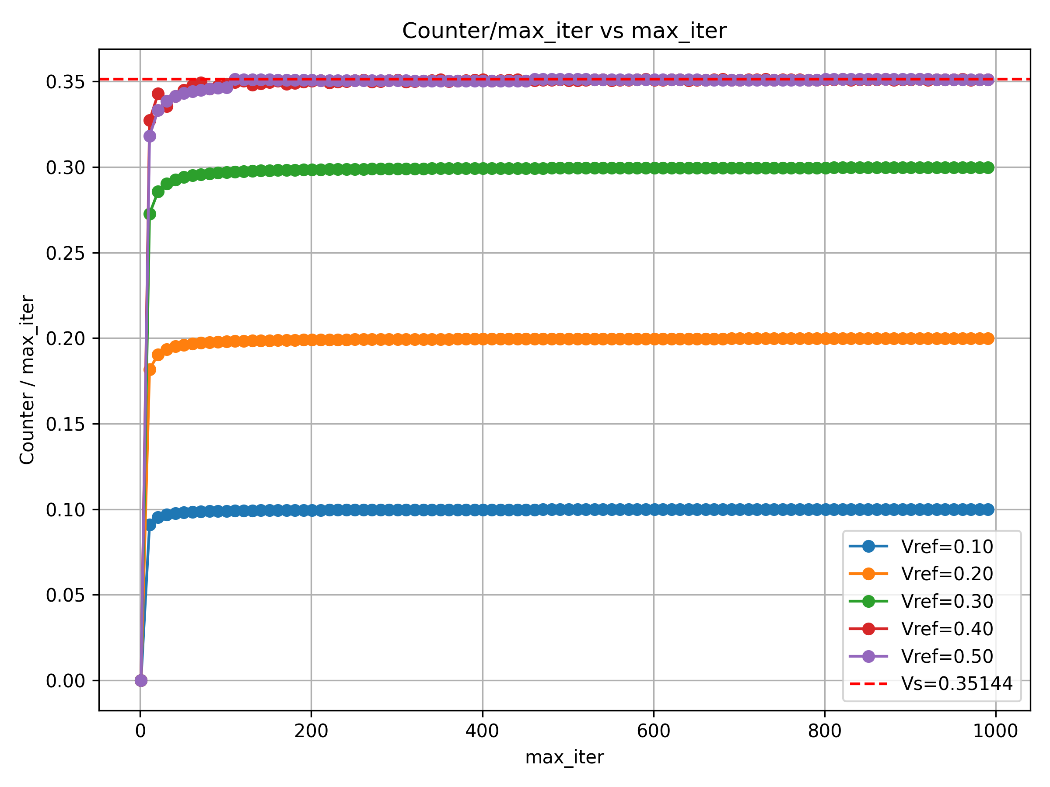

Effect of Iteration & Vcm & Vref
Vref
Vref has to be larger than all possible Vs to quantize
Small Vref will lead to wrong quantization result
Vref > Vs
Quantized properly
Vref < Vs
Converges to Vref rather than the result we want due to we only subtract Vref/2 every cycle
+ Vs/2 – Vref/2 per cycle

Slide 7
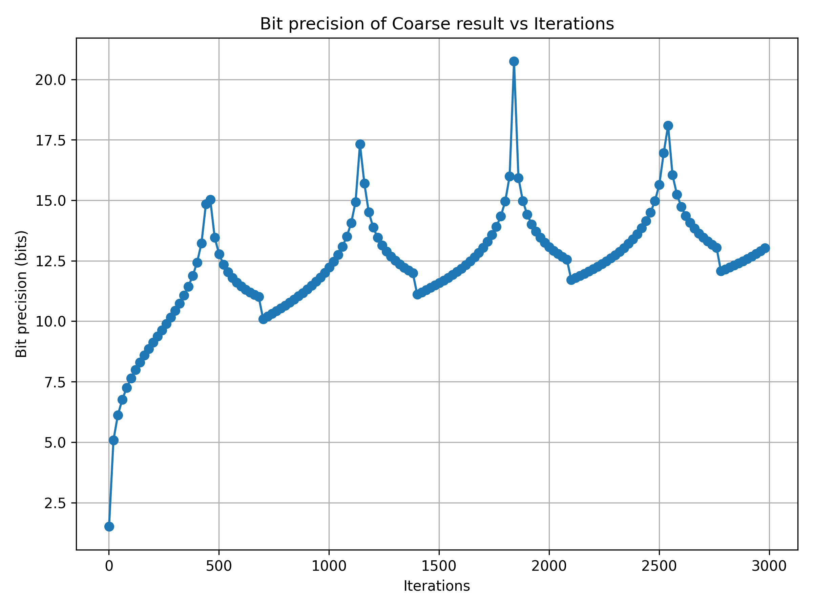

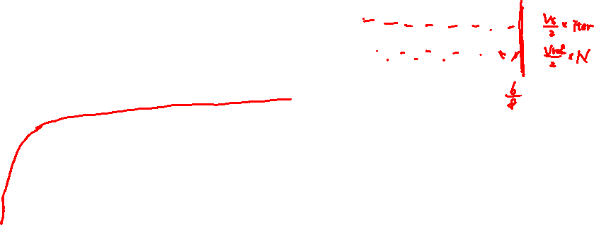
Bit Precision of Coarse-Grained Value
Bit-precision
Bit-precision generally exhibits a logarithmic growth trend, but superimposed with local periodic variations.
Red : $iter⋅\frac{V_{s}}{2}$
Blue: $N⋅\frac{V_{ref}}{2}$
OUT precision : 21 bit
Coarse-grained : roughly 13 bit

Slide 8
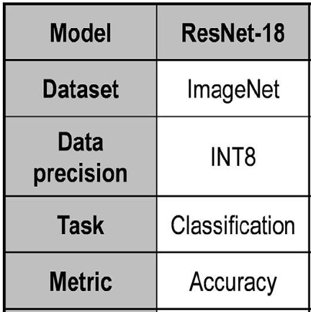
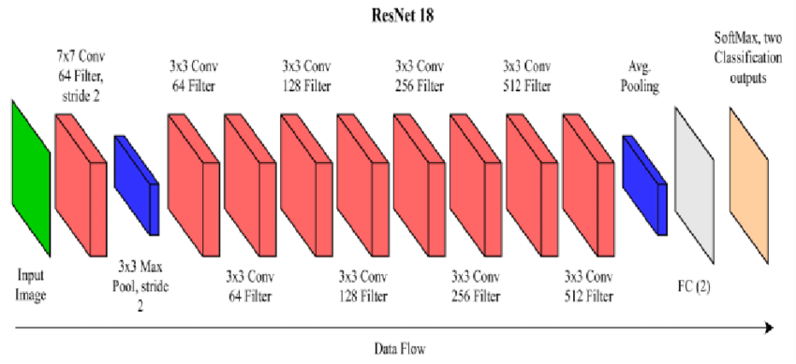
Impact of Poor Precision on ML Tasks
The dataset used in the paper is ImageNet
ImageNet is not implemented in torch
Use a simpler dataset CIFAR-10
ResNet-18
Trained using fp precision
Quantize to int8 after training
Compute MAC result for each layer and apply loss
-LOSS
Gaussian(-Loss,0.01)

Slide 9
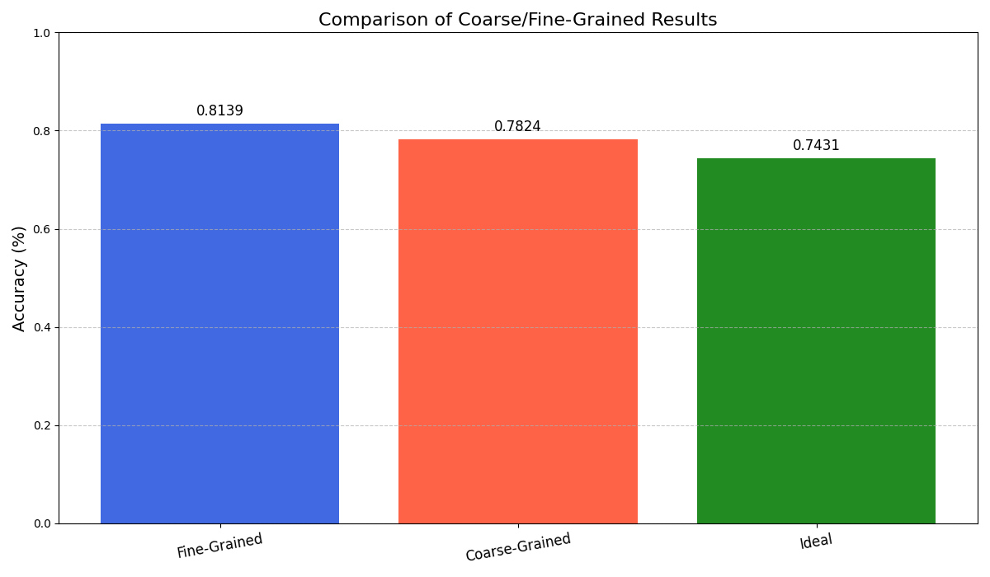
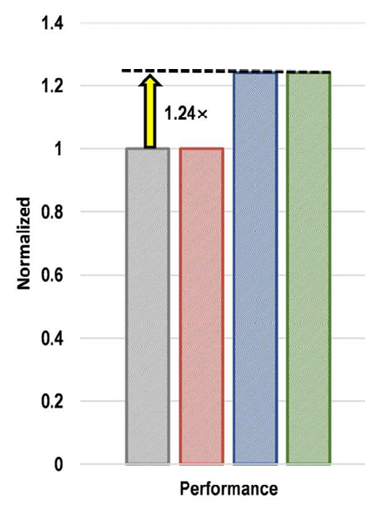
Impact of Poor Precision on ML Tasks
Comparison between coarse/fine-grained value
DGCQ : Merge 2 types of granularity
3.15% drop
7.08% drop
Lossless
Fine-Grained
Coarse-Grained

